Slide 1


Applying sociolinguistic research to the English Language classroom
Sue Fox Jenny Cheshire
University of Bern Queen Mary, University of London
Susan.fox@ens.unibe.ch J.L.Cheshire@qmul.ac.uk
Applying Linguistics Fund: Innovation and Impact
BAAL, Manchester Metropolitan University, 29-31 Aug, 2019

Slide 2
Linguistic Innovators: the English of Adolescents in London (2004-7)
Investigators:
Paul Kerswill (Lancaster University; now at York)
Jenny Cheshire (Queen Mary, University of London)
Research Associates:
Sue Fox
Eivind Torgersen
University)
Funded by the Economic and Social Research Council
http://www.lancs.ac.uk/fss/projects/linguistics/innovators

Slide 3
Multicultural London English: the emergence, acquisition and diffusion of a new variety (2007-10)
Investigators:
Paul Kerswill (Lancaster University; now at York)
Jenny Cheshire (Queen Mary, University of London)
Research Associates:
Sue Fox
Arfaan Khan
Eivind Torgersen
Funded by the Economic and Social Research Council
https://www.lancaster.ac.uk/fss/projects/linguistics/multicultural/overview.htm

Slide 4

From Sociolinguistic Research to English Language Teaching
January – December 2011
Investigators:
Jenny Cheshire (Queen Mary, University of London)
Sue Fox (Queen Mary, University of London; now at Bern)
Paul Kerswill (Lancaster University; now at York)
Follow-on Grant from the Economic and Social Research Council
https://www.qmul.ac.uk/sllf/linguistics/research/socio/english-language-teaching/

Slide 5
With whom were we trying to engage and why?
Advisory group
We worked with an advisory group of 14 teachers, from the north and south of England
2 of the teachers were also experienced examiners for GCE A level English Language and GCSE English Language
1 of the teacher/examiners writes textbooks for A level English Language and GCSE Spoken English Language

Slide 6
Website Linguistics Research Digest
https://www.qmul.ac.uk/sllf/linguistics/research/socio/english-language-teaching/ http://linguistics-research-digest.blogspot.com/
Data bank Research summaries
Sound clips, Transcripts,
Discussion points
Links to UK GCSE Links to GCE A Level curricula Language Investigations
From sociolinguistic teaching to English Language teaching

Slide 7
Databank of Spoken English
  12 folders, each with
  - a sound clip from our London projects
  - a written transcript of the clip
  - a set of discussion points
  - a separate glossary of the linguistic terminology used in the discussion points
  https://www.qmul.ac.uk/sllf/linguistics/research/socio/english-language-teaching/databank-of-spoken-english/

Slide 8
Linguistics Research Digest
http://linguistics-research-digest.blogspot.com/
The Digest provides up-to-date reports on recent journal articles in an engaging, jargon-free way
the chosen articles are specifically relevant to the specifications for UK GCSE and A-Level English Language
the Digest is open to anyone with an interest in language but particularly aimed at helping teachers of English Language to keep abreast with cutting edge research

Slide 9
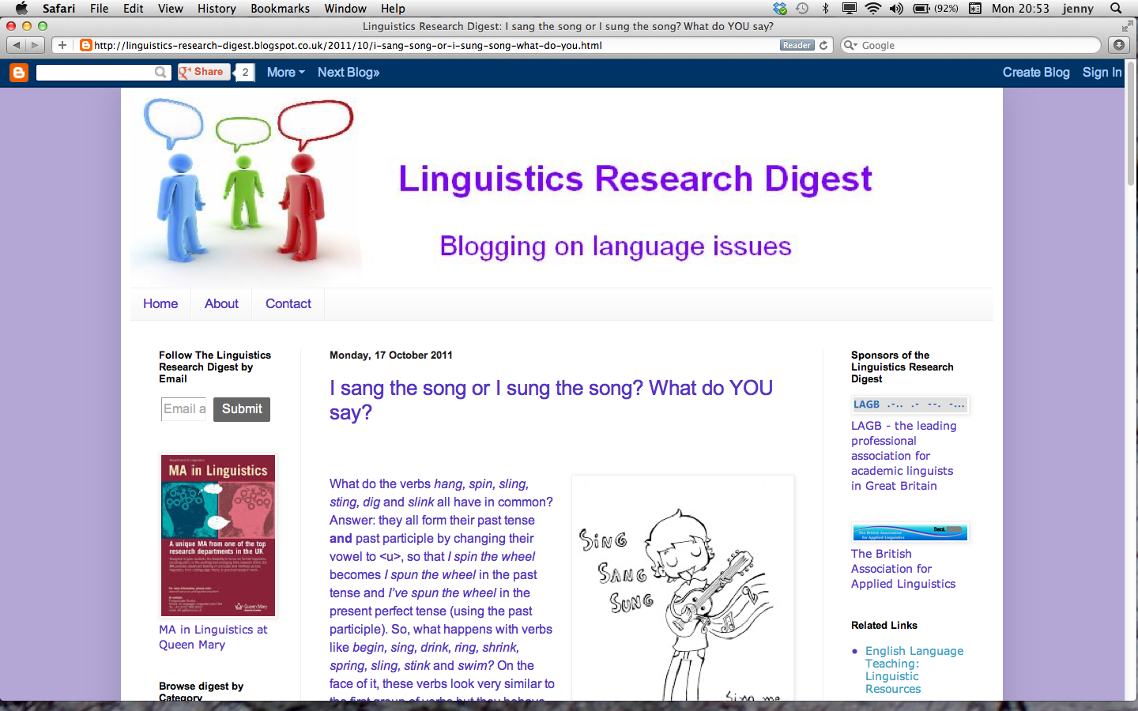

Slide 10
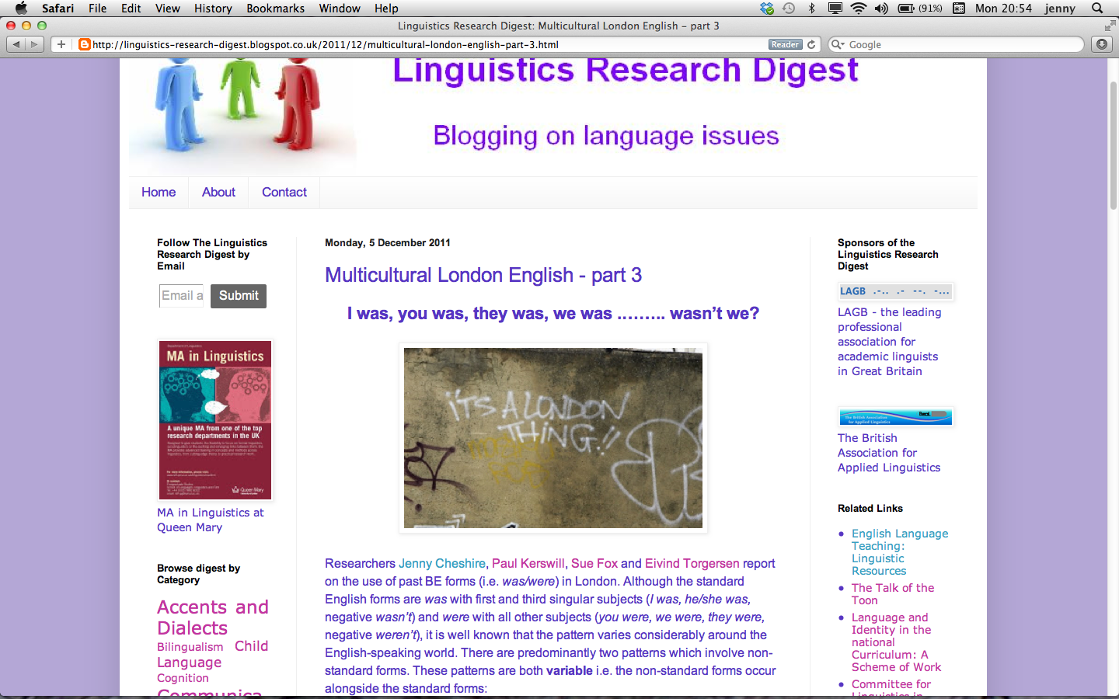

Slide 11
Linguistics Research Digest
Not in the same league as the HuffPost but gets about 260 hits each day (8000 each month)
Since 2012 the Digest has been sponsored by the Linguistics Association of Great Britain and the British Association for Applied Linguistics
It won a BAAL ‘Applying Linguistics’ award in 2012
Now sponsored by QMUL as part of the Linguistic department’s public engagement work

Slide 12
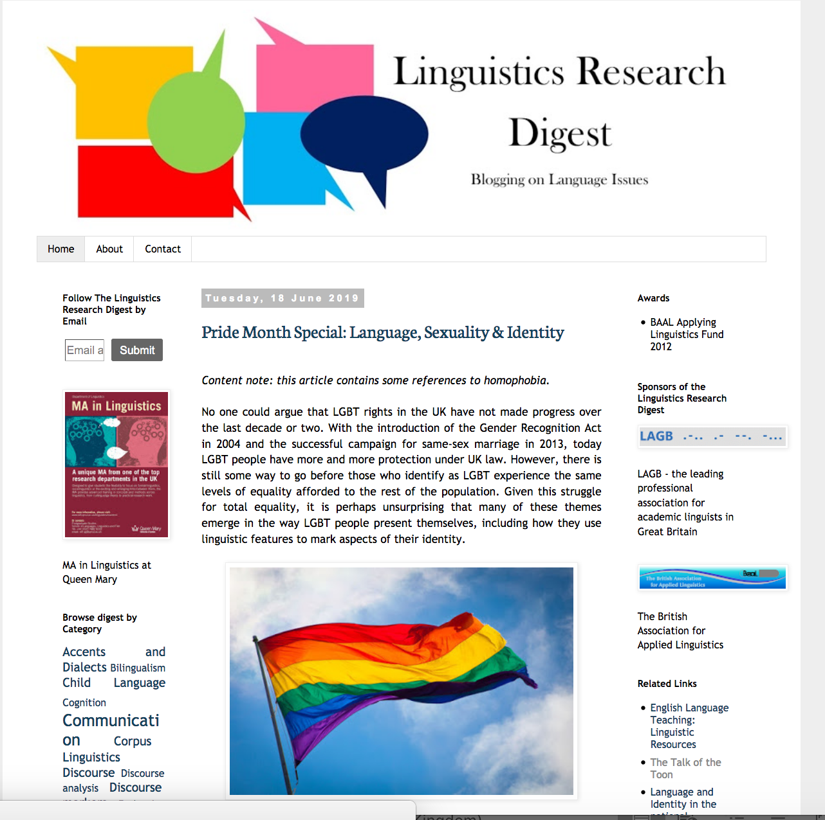

Slide 13
Thank you for listening!
Exciting new teaching resources at QMUL can be found here:
http://www.teachrealenglish.org/teaching-units/spoken-london-english/

