Slide 1


Applying linguistics in practice:
Language and communication training for police interviewers
BAAL Conference, Manchester, August 2019
Dr Kate Haworth & Dr Nicci MacLeod,
Centre for Forensic Linguistics, Aston University

Slide 2
The starting point
Kate Haworth & Nicci MacLeod both completed PhDs on the language of police interviewing (suspects / witnesses)
Important findings about what goes on in the police interview context interactionally (= academic/linguistic)
Specific findings about the mechanisms – and extent – of the interviewer’s influence over what the interviewee says (= practice)
Our research was designed with practice in mind – built in a priori
Explicit agenda to inform and improve police interviewing
BUT how do we get our message across to practitioners?

Slide 3
‘Impact’ and ‘application’: underlying principles
‘Impact’ can’t simply be an add-on or afterthought
‘Application’ has to mean more than simply telling people what we’ve discovered in our research
Research is better when it is informed by practice; practice should benefit from being informed by research
Needs to be a two-way process, not an imposition
Contextual knowledge and understanding are essential
Reaching the right audience, and having the right message

Slide 4
(Get to) know your context
43 different police forces in England and Wales
All bound by the same national legislation, guidelines, protocols, etc (PACE 1984; PEACE training model; case law, etc)
But each force has autonomy in designing and delivering its own training
So there is already a lot of police interviewer training available!
We couldn’t simply go in for a few hours and overturn their entire practice, or conflict with everything else they’re being trained in
There are also professional and commercial sensitivities: don’t offend your hosts, or start a turf war!

Slide 5
BAAL Applying Linguistics Fund - what we did:
Approached 3 police forces (using our existing links), offered them free training - in return for their feedback. All said yes!
Format of activities:
One-day training sessions
Participants completed questionnaires and took part in a focus group (n=52)
Materials revised in response to feedback before delivery to next force
Outcome to be a set of training materials, produced with input from practitioners and tailored to what participants found most useful
Intended to form a pilot study demonstrating the potential for linguistics to be integrated into interviewer training

Slide 6
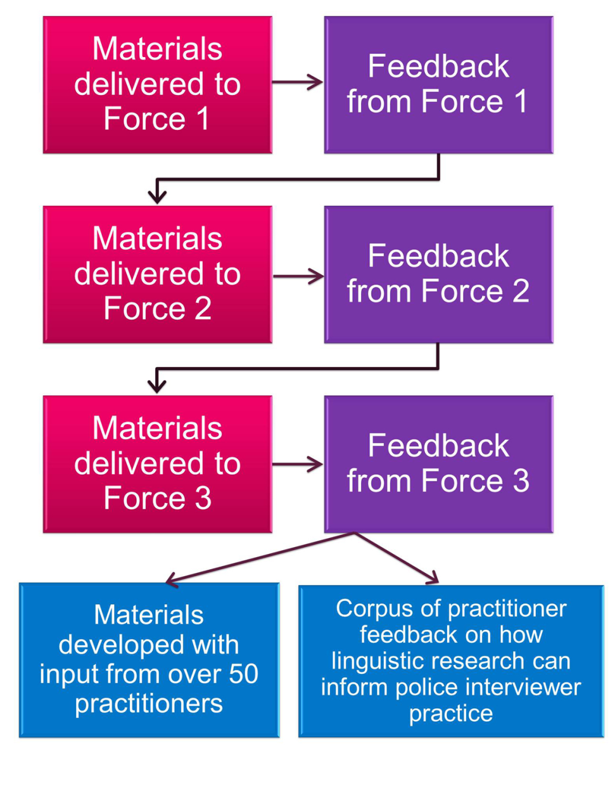
Structure:
Linguistic concepts:
  Turn-taking (CA)
  Pragmatics
  Language and power
  Participation frameworks
  Language and identity
  Audience design
  Formulations
Content:
  Real data examples
  Emphasis on providing practical skills and tools
  Underlying aim of instilling deeper understanding of discursive roles of interviewer/-ee

Slide 7
The reward? Great practitioner feedback!
Overwhelmingly positive response from participants
Every linguistic feature we had selected was mentioned by at least 2 participants as the ‘most useful’ for them
Over half the participants could identify nothing that was ‘least useful’
Great vindication of our analytic approach, feature selection & research findings
Strengthens our research as well as providing useful input for practitioners

Slide 8
Feedback: they genuinely want our input!
As a practitioner
it is always good for me to listen to Academics. Definitely had ‘real life’ value. Thanks.
More than
anything, it is nice to know what a linguist makes of it, rather than training written by police officers.

Slide 9
Feedback: they will actually use it in practice!
‘All today’s training has been relevant and will assist me in any future interviews I do.’ (SYP7)
‘the subject is very relevant to conducting better interviews and valuable to any interviewer’ (SYP6)
‘It has provided a different perspective, provided new concepts, and an improved understanding. More tools for the interviewers box.’ (SX15)

Slide 10
Advice for applicants / appliers of linguistics
Identify your message:
- What is your point?
- What do you want to achieve?
Identify your target audience:
- Who can actually implement it? (Policy makers, managers, frontline staff, professional bodies…?)
Find the best ‘entry point’ / angle:
- Learn about the context, build links, join organisations, avoid ‘cold-calling’

Slide 11
Advice for applicants / appliers of linguistics
Make it a collaboration, not a ‘transfer’
Find out what they actually want or need, and use their input on what will work in practice
Decide what you really want out of it, too
Check what support your institution can provide
Think carefully about what you are promising; the implications of your findings; what the consequences of your intervention might be, for both of you
Be alert to developing loyalties, friendships, biases; insider/outsider perspectives can be gained AND lost
Think about potential conflicts, affiliations, ‘sides’ (e.g. pros/def) – trust and integrity are essential

Slide 12
The down side… so now what?
We haven’t been able to take this any further, due to lack of time & funding
Despite the ‘impact’ agenda, REF, etc, there’s not a lot of support for genuinely applying research (as opposed to doing the research which underlies it, or writing publications about what you did)
Takes a significant amount of time and personal investment, none of which fits with academic expectations of what we do with our time
BUT it is totally worth it, especially for the quality, validity and relevance of your research
The BAAL Applying Linguistics Fund is a golden opportunity – use it wisely!

Slide 13
For more details of our project:
MacLeod, N. and Haworth, K. (2016) ‘Developing a Linguistically Informed Approach to Police Interviewing’. In R. Lawson and D. Sayers (eds.) Sociolinguistic Research: Application and Impact. Abingdon: Routledge. 151—170.
Thank you BAAL!
    Dr Kate Haworth
    k.haworth@aston.ac.uk

